Slide 1


Proposed Gift Amendments &
Gift Related Issues for the Transition
David Apol, OGE/ Chris Swartz, OGE

Slide 2
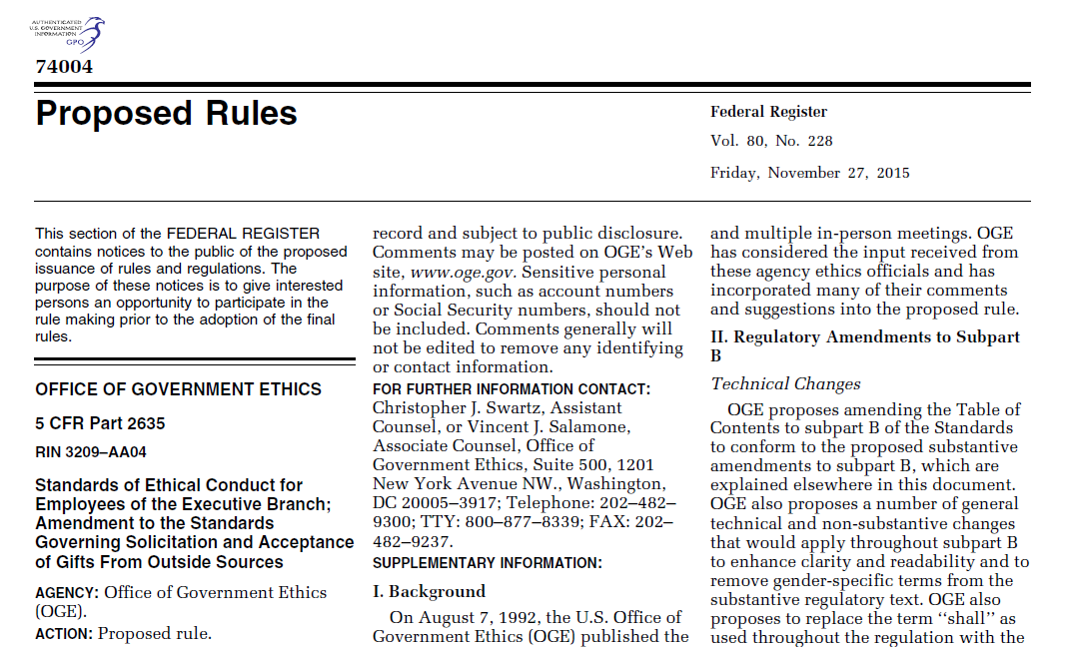

2016 Proposed Subpart B Amendments
November 27, 2015
80 Fed. Reg. 74004-74018
First Comprehensive Amendments since 1992

Slide 3
Proposed Regulation: Timeline
Winter
Winter
Spring
Summer
Fall
Winter
Spring
Summer
Spring
Summer
Fall
2013
2014
2015
2016
1
2
3
4
5
6
7
8
9
(1) Feb 2014: OGE Begins Review of Subpart B (continues through Nov. 2015)
(6) Aug. 2015- Nov. 2015: OGE Coordinates with OMB + Agencies
(2) May 2014: OGE Surveys Ethics Officials
(7) Nov 2015: OGE Publishes Proposed Rule
(3) Sep. 2014- Mar. 2015: OGE Receives Agency Input on Draft
(8) Jan. 2016: Comment Period Closes
(4) Feb: 2015: OGE Holds In-Person Meetings with Ethics Officials
(9) Spring-Summer 2016: Anticipated Date of Final Rule Publications
(5) Mar. 2015- July 2015: OGE Coordinates with OPM/DOJ

Slide 4
Proposed Regulation: Comments

Slide 6
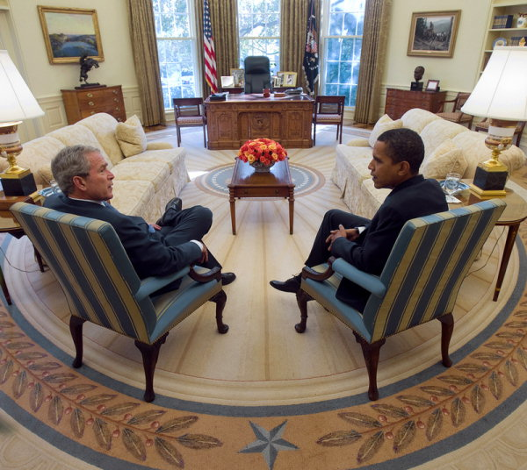
Presidential Transition & Election Period
Gift Topics

Slide 7

Transition & Election Related Gifts
Hatch Act Exception, 5 C.F.R. 2635.204(f)
Political Conventions & Associated Parties
Inauguration Parties
Gifts Between Employees & Transition Team Members
Going Away Gifts To Outgoing Appointees
Gifts To Pre-confirmation Nominees
Gifts For New Appointees & Swearing-in Parties
Reporting Politically-related Gifts (OGE Form 278/450)

Slide 8
5 C.F.R. 2635.204(f): “The Hatch Act Exception”
Provides a limited exception permitting the acceptance of otherwise prohibited gifts from outside sources if:
The employee may take an active part in political management or political campaigns. See 5 C.F.R. 734.201-208.
The gift is given in connection with active participation in the political management or in a political campaign
The gift is provided by a 527(e) organization

Slide 9
What is a 527(e) “political organization”?
Examples of 527(e) organizations:
National Political Party Committees
State & Local Party committees
Authorized Candidate Committees
Political Action Committees
Nonconnected Committees (e.g. Leadership PACs)
Some Corporate or Labor Separate Segregated Funds (SSFs) (if 527)
Examples of Non-527(e) organizations:
501(c)(3) Charitable Organizations
501(c)(4) Social Welfare Organizations
For-profit Law firms & Consulting agencies
Other organizations and individuals affiliated with, but not agents or entities of, a 527(e)
Hint: Check the IRS Website for Form 8871 Filings!

Slide 10
E.O.13490 & The Hatch Act Exception
Full-time, non-career appointees in the Executive Branch must pledge to: “not accept gifts from registered lobbyists or lobbying organizations.”
Some exceptions available; not 5 C.F.R.2635.204(f).
Thus, If:
Gift is from a registered lobbying organization, or
Person offering the gift is a registered lobbyist
Pledge signer would not be able to accept.
See e.g., OGE DO-09-007; OGE LA-12-10

Slide 11
Scenario: Hatch Act Exception (1)
Mindy is a GS-12 analyst with the Department of Labor. She is a less restricted employee and can therefore participate in political organizations. On the weekends during election season she travels to various states to help her party drum up support for a particular candidate. Occasionally a state party organization will offer her and others with free lodging while they are in-town with a candidate. Can she accept the offer of lodging?
What if Mindy was a Schedule C, full-time political appointee and the person providing Mindy with the gift was a registered lobbyist?

Slide 12
Scenario: Hatch Act Exception (2)
Let’s change the facts slightly:
Occasionally while Mindy is in town she will be asked to attend dinners with representatives of organizations that are considering endorsing the candidate that Mindy favors. Mindy does not engage in fundraising during these dinners.
Generally Mindy pays for these dinners out of her own funds, however, last weekend she went to a dinner with the head of an influential labor organization who offered to pick up her tab of $50.
The Department of Labor has interfaced with the labor organization in the past, and is likely to do so in the future, but the labor organization has no matters currently before Mindy’s “employing office.” Can she accept?

Slide 13
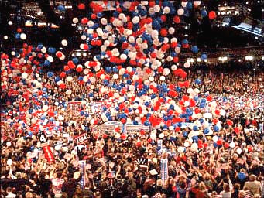
Political Conventions & Associated Parties
Major Party Political Conventions Typically Held Outside of D.C.
Volunteers may be able to rely on the Hatch Act exception for transportation, lodging, food, etc.
Not from 527(e)? Can’t use Exception
Expect Numerous D.C. Parties
Held by 527(e)?
Privately Sponsored?
Who Pays?

Slide 14
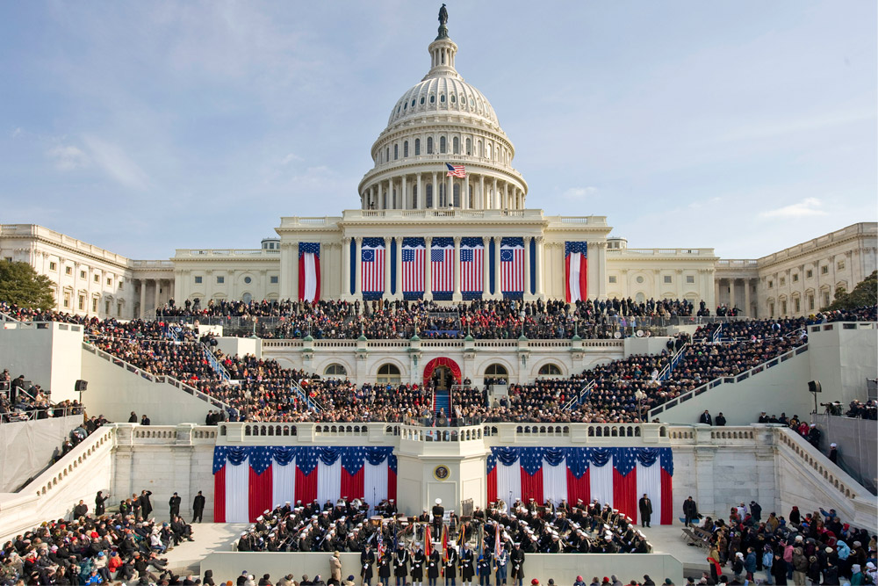
Inauguration Events
Presidential Inaugural Committee (PIC):
Because of its sui generis nature, gifts from the PIC are not prohibited under Subpart B. See DO-09-001.
527(e) Political Organizations:
May qualify under Hatch Act exception
Other Sources/Privately Sponsored:
Is it a gift?
If so, is the gift prohibited?
If so, is there an exception?

Slide 15
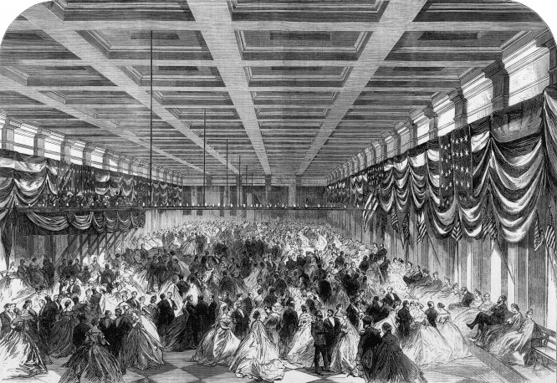
Inauguration Events, Cont.
Possible Exceptions
Gifts of $20 or less: Note that any events for which there are tickets are to be valued according to the face value on the ticket.*
Gifts that are clearly motivated by a family relationship or personal friendship.
Gifts offered by political organizations if in connection with their political participation.*
Widely attended gatherings if in agency interest. Review OGE 07 x 14 regarding Social Events first.*
See also OGE LA-12-10.
*Not available to Pledge signers if from registered lobbyist or lobbying organization

Slide 16
Scenario: Inaugural Events
Cesar works at HUD in a supervisory position. Cesar is not a more restricted employee. During the election period, he frequently attended fundraisers in the D.C. Metro area for his favorite candidate, who was eventually elected to be the President. Cesar is not involved in the transition, but is very excited that the candidate won the election.
Three days before the inauguration, he receives a phone call from a local real estate management company, offering him two tickets to attend an inauguration party. Can he accept?
Let’s say that instead of a local real estate management company, it was the 527(e) organization that he was affiliated with, which wants to reward volunteers for their hard work on the campaign by offering them free attendance at an unofficial event thrown by the political organization? What if they want to provide Cesar with tickets to the official inaugural ball?

Slide 17
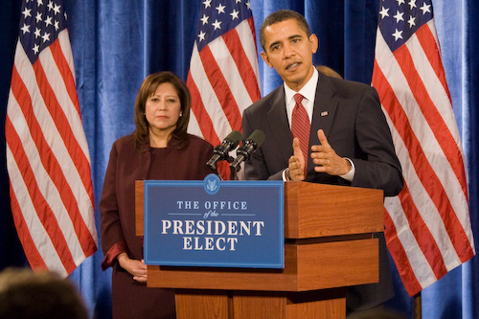
Gifts to and from Transition Team Members
Transition team not part of Gov’t, typically established as non-profit 501(c)(4).
Members of the transition team are generally not executive branch employees, unless on detail.
They may be volunteers from outside the Government, Congressional employees, state employees, or campaign workers.
Must analyze gifts under Subpart B.

Slide 18
Gifts to and from Transition Team Members
Transition Team will likely have a code of conduct.
Highly encouraged: See ACUS Recommendation 88-1 (1988).
Typically Code will impose limitations on transition team members from accepting bribe-like gifts
Some members may also be subject to Congressional or State rules!
Obama-Biden Transition Team Code of Ethical Conduct
Bush-Cheney Transition Team Code of Ethical Conduct

Slide 19
Gifts to and from Transition Team Members, Cont.
Obama-Biden Transition also limited circumstances in which transition team members could accept gifts in similar fashion to the Standards of Ethical Conduct

Slide 20
Scenario: Transition Team Members
Sam is a career official with the Department of the Navy who is also the senior transition coordinator for his agency.
During the transition period he is tasked with interfacing with the defense “parachute” team from the transition, and does so on a daily basis. The transition contact he works with volunteers with the transition, but works with a major defense contractor full-time.
Sam and the transition contact met for the first time at the first meeting between the Department and the transition team.
Following a tabletop exercise held at Navy offices, the transition contact offers to take Sam out to watch a basketball game at the Verizon center.
Tickets cost $70 each. Can he accept?

Slide 21

Going Away Gifts to Outgoing Appointees
Subpart C of the Standards of Ethical Conduct, “Gifts Between Employees” will continue to apply to gifts given to outgoing appointees until they terminate Government service.
Generally, employees may not:
Give gifts to an official superior, or
Solicit other employees for contributions to a gift for an official superior
Exceptions:
Gifts appropriate to the occasion upon termination of the superior-subordinate relationship
May solicit voluntary contributions of nominal value for appropriate gifts to superior terminating
You’re Invited to Say
Goodbye!
To the Director

Slide 22
Scenario: Outgoing Appointees
Naomi works at the Department of Health and Human Services. She entered into Government service in 2010, and has worked under the same supervisor, Antonia, since she began. Antonia has decided to leave after the transition to seek employment in the private sector. Naomi would like to buy Antonia a gift. Which of the three gifts below would be most appropriate?
A three-day resort vacation at a well-known resort located in southern Florida?
A $700 dollar bottle of champagne, purchased solely by Naomi?
A $50 day-spa gift certificate to a local masseuse?

Slide 23
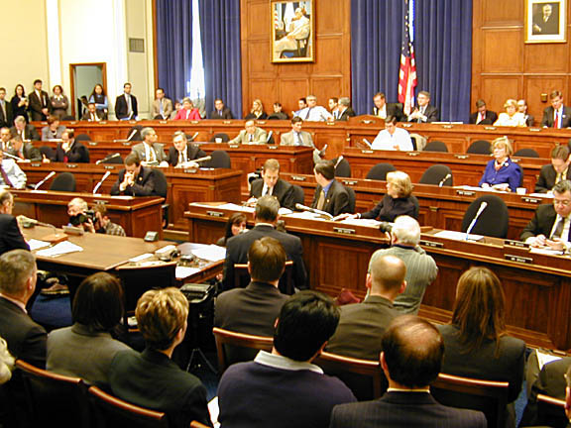
Gifts to and from Pre-Confirmation Nominees
Nominees may have lag time between nomination and appointment.
If not in a Federal position during pendency=
Gifts analyzed under Subpart B
If in a Federal position during pendency=
Gifts analyzed under Subpart C
Provided OPM criteria are met, expert and consultant appointments (5 U.S.C. 3109) may be used for:
Individuals who have been nominated by the President, but not yet confirmed
Individuals whose permanent excepted appointments are in process.
Average days between nomination and confirmation of appointees nominated during first year:
President Obama (60.8)
President Bush (57.9)
President Clinton (48.9)

Slide 24
Scenario: Pre-Confirmation Nominees
Arun is a career SES with the Department of Energy.
Recently, the new President nominated Sally to be Director for the Office of Science, a position requiring Senate confirmation.
Sally and Arun went to college together, but haven’t spoken for many years.
Sally is expected to be confirmed quickly, but until she is confirmed the Department of Energy has determined that she meets the criteria of an expert under 5 U.S.C. § 3109, and has contracted for her to encumber a temporary position with the Office of Science.
Arun would like to take Sally out to celebrate her nomination. Can he?

Slide 25

Gifts to New Appointees & Swearing-In Parties
Subpart C will apply to incoming appointees at the time they enter upon the duties of their office (i.e. time they begin to accrue their salary). 26 O.L.C. Op. 32 (2002)
Because not a termination of superior-subordinate relationship, only:
Non-cash gift of $10 or less
Items, such as food, shared among employees
Sometimes agency wants to throw party:
Appropriations (normally can’t use appropriations for free food and entertainment in duty station)
Sometimes former employer wants to provide funds:
Appropriations (agency gift acceptance)
2635 Subpart B

Slide 26
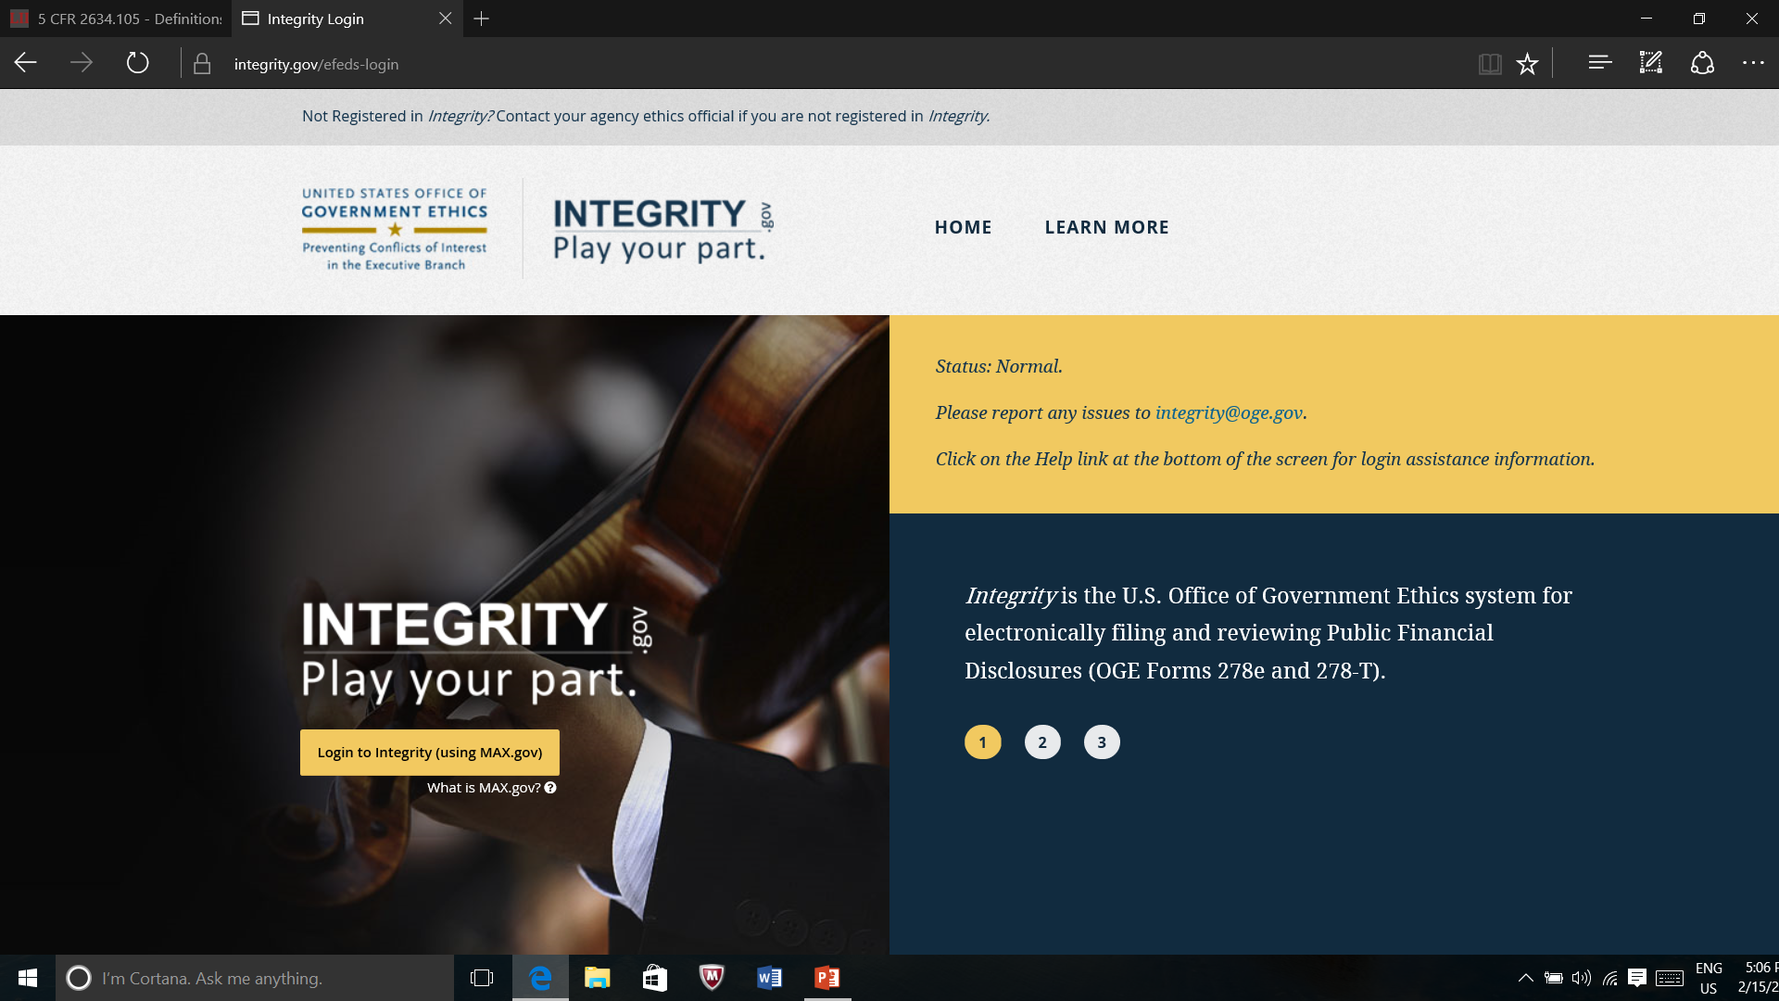
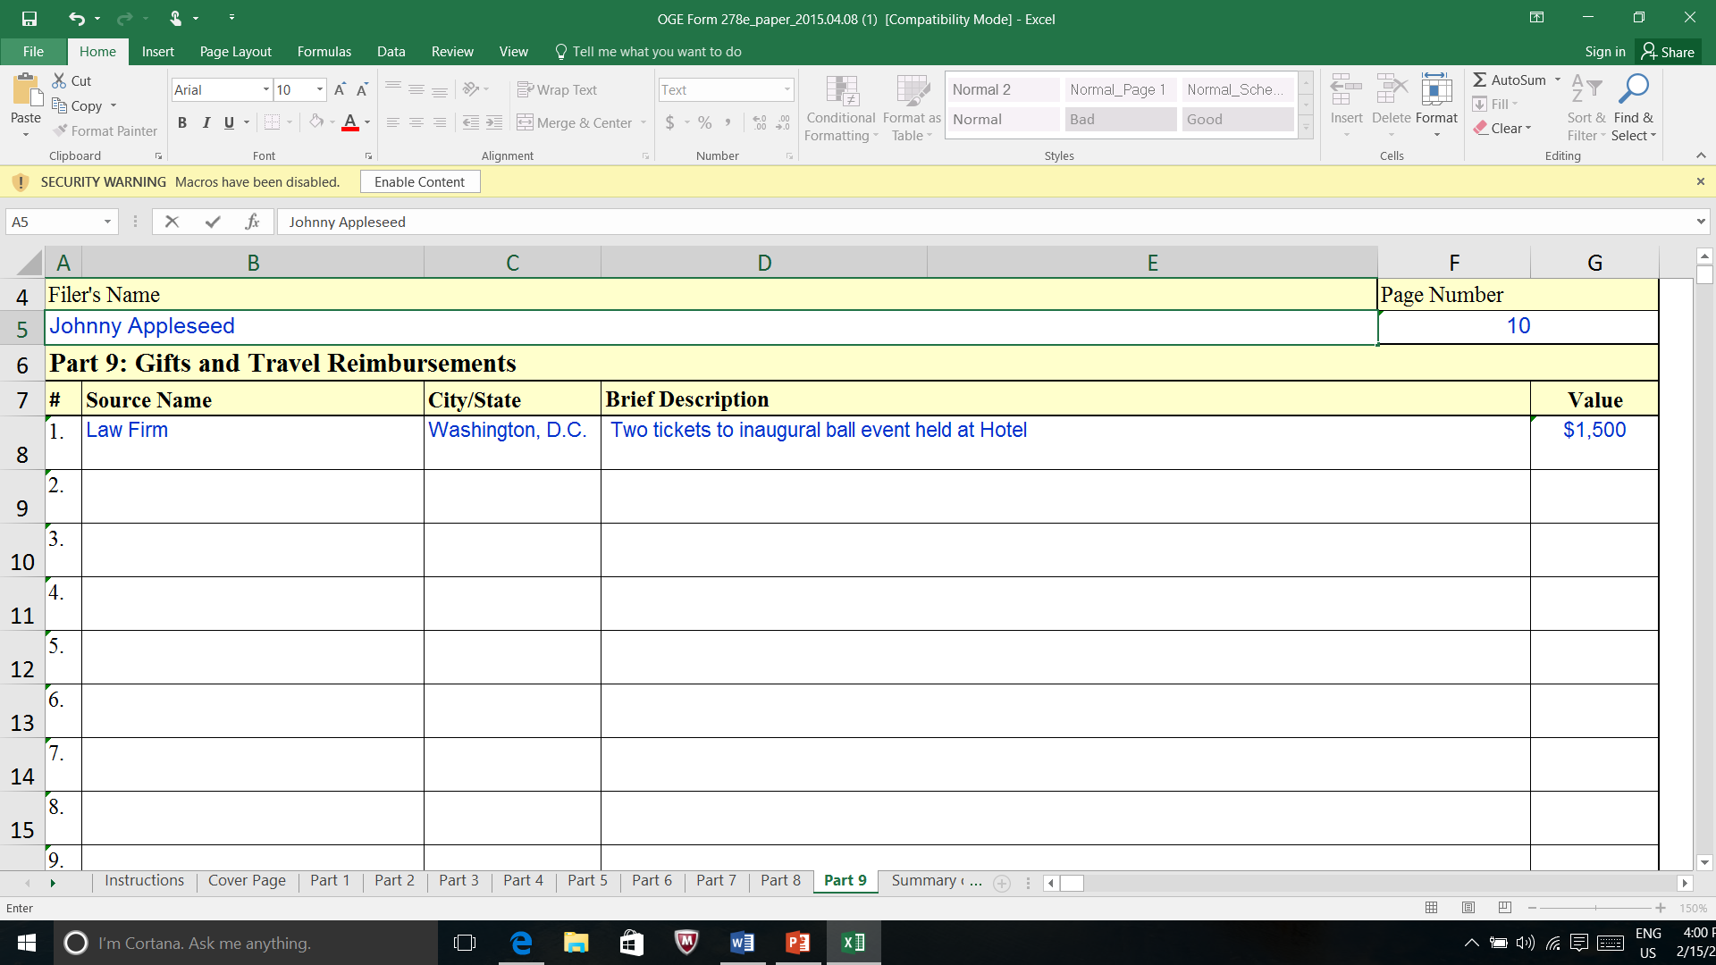
Reporting Gifts: OGE Form 278e & 450
278e & 450 Filers:
Received a gift over the threshold? REPORT!
($375 per source, not including gifts $150 or less)
U.S. v. Joseph McCloskey
Filer didn’t report gifts from CEO of prohibited source, including tickets to inaugural event, on his OGE Form 450
Charged with violating 18 U.S.C. 1018 (false certification) & sentenced to 12 months probation, and a $1,000 fine.
See OGE LA-11-08

Slide 27


